Slide 1
Title (Helvetica; 43; bold)
Name (Helvetica; 22)
Organic Interfaces and Orbital Tomography
Date - Location

Slide 2
Outline
First section (Helvetica; 20; bold)
First subsection (Helvetica; 20; indented by 5 blank spaces)
Second subsection
Second section
First subsection
Second subsection
Put a white square with 20% transparency and
the animation: “Appear” on the later sections

Slide 3
Slide with text only
Some text, and something you want to highlight
Font: Helvetica – please install it, if you don’t have it yet
Font size for “normal” text: 20
Please use the correct colors (grey and blue): They are defined as “designcolors”
  grey: #59575d (RGB: 89, 87, 93)
  blue: #8ec0d7 (RGB: 131, 189, 209)
Please enter your name as a footnote (and adopt it for all slides)
Put one blank space after the dots in a list

Slide 4
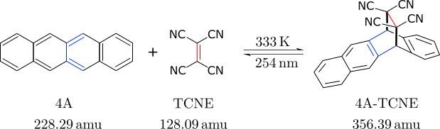
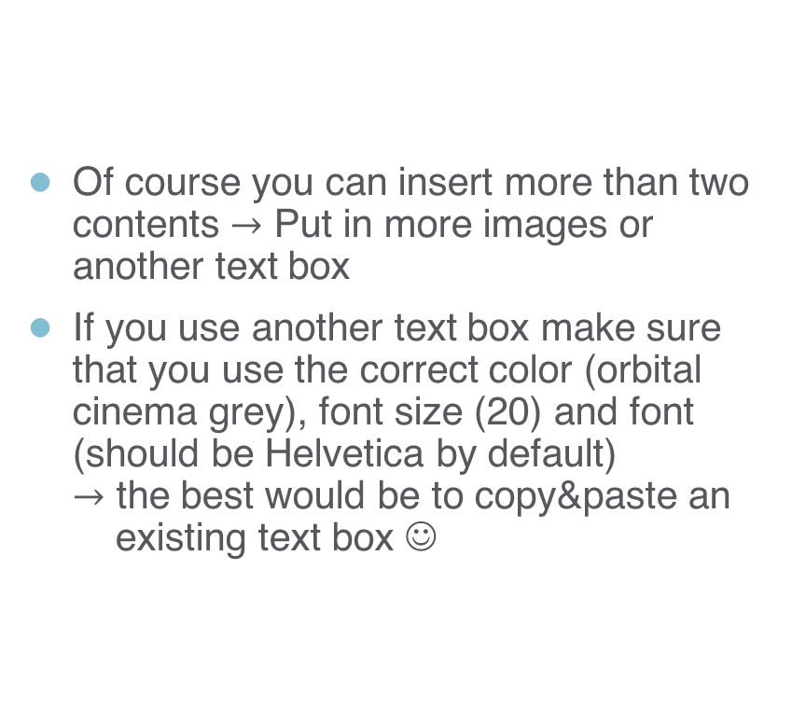
Two contents next to each other
Of course you can insert more than two
contents $→$ Put in more images or
another text box
If you use another text box make sure
that you use the correct color (orbital
cinema grey), font size (20) and font
(should be Helvetica by default)
$→$ the best would be to copy&paste an
existing text box ☺

Slide 5
Outline
First section (Helvetica; 20; bold)
First subsection (Helvetica; 20; indented by 5 blank spaces)
Second subsection
Put a white square with 20% transparency on the sections which are not the next one
Second section
First subsection
Second subsection

Slide 6
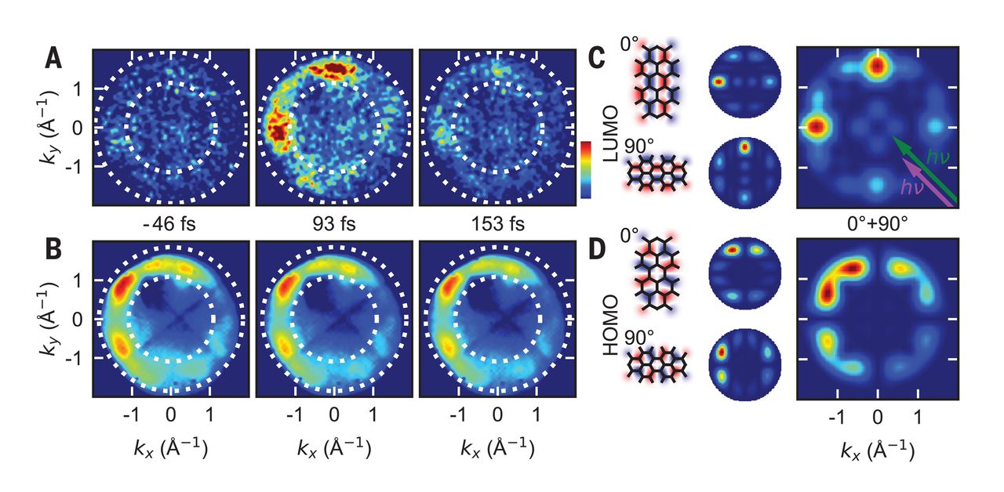
Image, text and reference
For references use the following format:
1st Author et al. Journal Vol, page (year)
Only ‘et al.’ is written in italics
Only the volume is written in bold
Fontsize: 14 (Helvetica)
Wallauer et al. Science 371, 1056 (2021)

Slide 7
Conclusion

